Slide 1

Expect Beyond

Slide 2

Expect Beyond
Merino Rationale
Expect Beyond Dimensions
The Brand name, Merino (IT Services), is derived from the parent company, Merino Industries. The logo symbolizes growth propelled by three important aspects people, processes and services. While the three arcs represent people, process and services, the green arrow is a sign of prosperity and growth.
The positioning ‘Expect Beyond’ came from the consumer’s insight which assures a complete bond between Merino and its clients.

Slide 3


Consumer expectations drive us to do better.
When they want big, we create big enough.
Every new opportunity
comes wrapped in a new challenge.
Challenges are an inseparable part of our lives. We take the challenges head on, learn from them, and uncover the hidden opportunities lying inside.
From health-check to deployment
and then application management, a complete range of services help meet the varied needs of the businesses. Aside from that, we are creative enough to custom-design a solution depending on the need of the hour.
More than a decade has passed since we stepped into the arena of Information Technology. And since then, we have been analysing consumers, understanding their problems and making them believe in the reality of deploying technology solutions. Perhaps, we may not sound as appealing to our customers as an FMCG retailer, we exactly know what it takes to deploy Enterprise solutions. Furthermore, we understand what problems our customers go through and what they expect from us in response.
We take pride in making things a little easier for businesses, walking on our old school principles of eradicating challenges through PEOPLE, PROCESSES and
SERVICES. We make our customers count on us and
work round-the-clock to turn their expectations into reality – yep, that's exactly what we are so good at!
We are focused, with plenty
of experience under the belt.
13+ years of experience backed by some of the extraordinary minds help us meet even the toughest of the challenges that businesses face today. We sit together with our clients, share a cup of coffee, and go on to scrutinizing the possibilities of making a difference in their businesses.
Boundaries
cannot stop us.
Presence across multiple regions, 300+ clients - we have been helping global businesses for years whilst making a reputable place deep in their hearts. Having a keen eye for comprehending universal business problems, we think beyond the consumers’ expectations and provide them the best-in-class technology solutions.

Slide 4
About Merino Services
Merino Services, a global enterprise is part of a $250 million Merino Group, headquartered in India and has a strong presence in the USA, Canada, Europe, Middle East, South East Asia & India Subcontinent
The team consists of 200+ domain experts, serving 250+ clients across 41 countries
End-to-End service, ranging from Feasibility Study to Implementation of standard application to post implementation support along with AMS. We also add value to overall solution by designing & developing Mobility solutions
ISO 9001:2015 certified
GDPR Compliant

Slide 5

GLOBAL PRESENCE
Notes:
Portugal add

Slide 6
Merino Expertise
Services
Implementation and Consulting
Migration/Upgradation
Service and Support
Education and Training
Application Management
ERP Readiness and Health Checks
Solution
Enterprise Resource Planning
Customer Relationship Management
Enterprise Asset Management
Technology and Middleware
Enterprise Performance Management
Tecnology Alliance
Infor
Microsoft
IFS
Oracle
SAP

Slide 7
Merino’s Dual Advantage
VERTICAL SYSTEM INTEGRATION
Prediction, Simulation, CPS
Data Federation & Collaboration
Visualization, Monitoring, Analytics
Market to Order
Order to Cash
Idea to Offering
Forecast to Plan
CRM
SCM
Record to Report
Procure to Pay
ERP
Design to Build
Assess to Acquire
ERP
Operate to Maintain
Plan to Produce
PLM
EAM
HCM
Inspect to Quality
Acquire to Retire
HORIZONTAL BUSINESS PROCESS INTEGRATION
MOM / LMS - APS – MES - MI
PLC, SCADA, I/O Controllers, IIoT
Sensors, Actuators, RFID etc.

Slide 8

Services

Slide 9




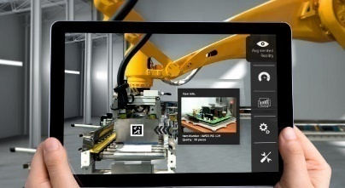



SERVICES OFFERINGS
Consulting Services
ERP Readiness and Health Check
ERP Implementation
Application Management Services
Manufacturing Excellence
Migration / Upgradation
Education & Training
Staff Augmentation

Slide 10

industries Focus

Slide 11












INDUSTRIES FOCUS
Equipment & Machinery
Discrete Manufacturing
Milling
(Metal, Paper & Plastic)
Automotive
High-tech Electronics
Food & Beverages
Textile
Aerospace & Defense
Distribution & Retail
Energy & Power
Ship Building
Wire & Cable

Slide 12






Did you know?
100,000+
100
80%
25k
Trucks, specialty
vehicles
Countries
Top Tier 1 Suppliers
Suppliers use Supplier Exchange
3000+
80%
16m
Industry Membership
Automotive suppliers
School buses assembled
Wheels a year
AIAG OESA MERA AAIA AASA CLEPA

Slide 13














Automotive Focus Industries
OEM/SV
Manufacturers
Tier 0.5
Suppliers
Tier 1
Suppliers
Tier 2-3
Suppliers
Distributors
Infor Automotive customers span all tiers of the Auto eco-system
and are most concentrated in Tier 0.5/Tier1

Slide 14




Industry Trends
Globalization:
To support rapid growth in emerging markets, auto part suppliers are merging and forming partnerships and joint ventures with local suppliers.
Shifting role of the Supplier: Consumers are demanding increased connectivity, convenience and safety features in their cars. This increases the need for R & D by suppliers.
Trends
More Older Vehicles on the Road:
Increased demand for aftermarket parts is driven by more people owning vehicles and keeping them longer.
Quality Control:
Many manufacturers require their suppliers to comply with QS9000 (quality control certification)

Slide 15




Business Challenges
Explicit Customer Requirements: Increasing demand for larger and more complicated component assemblies have created larger, but fewer auto part suppliers. Many tier 2 and tier 3 suppliers depend financially on a few large contracts.
Increased Product Complexity: Increasing sophistication of car components forces suppliers to upgrade product lines with more engineering and research and better coordination with customers.
Relentless Focus on Productivity: Auto manufacturers have squeezed supplier margins to the extent that some critical part vendors have concerns about their continued viability as a supplier.
Influx of Regulatory Issues: Stricter production standards require the auto suppliers to control hazardous and toxic pollutants. Some manufacturing plants struggle to meet OSHA and EPA standards.
Exodus of Expertise: Growing concern on skill shortage or deficiencies. High skilled technicians required to work on cutting-edge, high-tech tools.

Slide 16






Key Industry Metrics
Manufacturing Cycle Time
Days in Inventory
Average Supplier Lead Time
Overall Equipment Efficiency
YoY Cost Savings
Asset Utilization

Slide 17
Business Challenges
Address changing demand
Optimize the cost of doing business
OEM-Supplier Collaboration
Productivity
Regulatory
Talent
Product

Slide 18

Meeting your business challenges With micro-vertical specific functionality built-in, not bolted on

Slide 19


Work Efficiently
Excite and entice the best
Complete organizational information
Infor Difference
Desktop, Mobile
Context based presentation
Collaboration based communications
Infor’s easy to use and understand interface ensures competency without complex processes and training

Slide 20

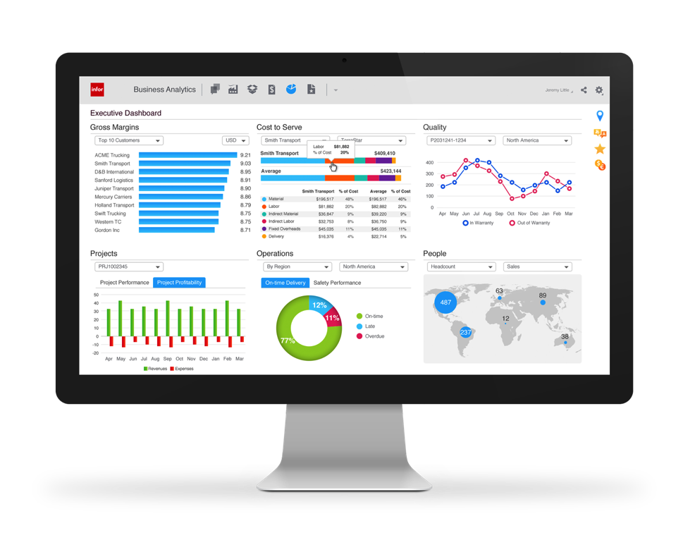

Complete automotive suite
Deep core ERP
Functionality plus ION
integrations to:
Automotive Exchange
Supplier Exchange
Asset Management
Budgeting & Planning
Warehouse Management
Supply Chain Planning
Product Lifecycle Management
Implementation
Accelerator
Micro-vertical Analytics
Industry business processes
pre-configured database & solution

Slide 21
Automotive Business Processes
Strategy and vision
Enterprise strategy
Organization management
Core functions
Customer relationship management
Automotive order management
Product development
Sourcing & procurement
Planning and scheduling
Materials management
Production management
Quality management
Support functions
Financial
management
Human capital management
Enterprise asset management
Technology

Slide 22

Making innovation work for you

Slide 23

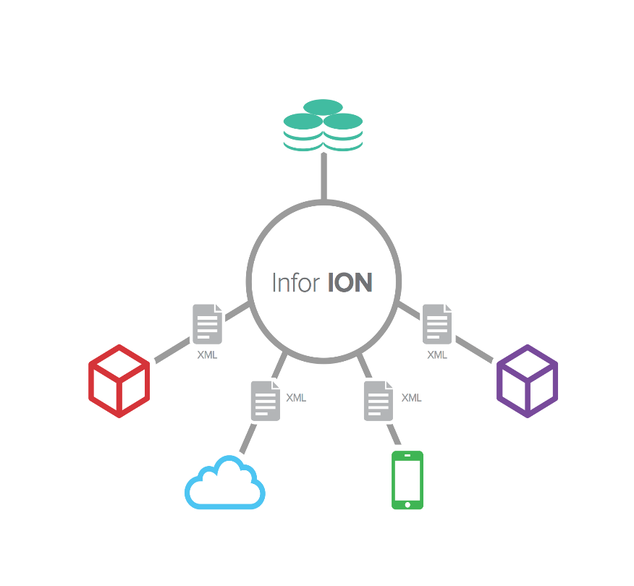
Business Vault
Analytics | Reporting | Search | In-context BI
Integrate disparate systems simply with greater business process flexibility.
Upgrade independence
Workflow and alerts across systems
Change business processes as needed
Create real time data repository
Built to OAGIS and internet standards
Application
Application
Cloud
Motion

Slide 24

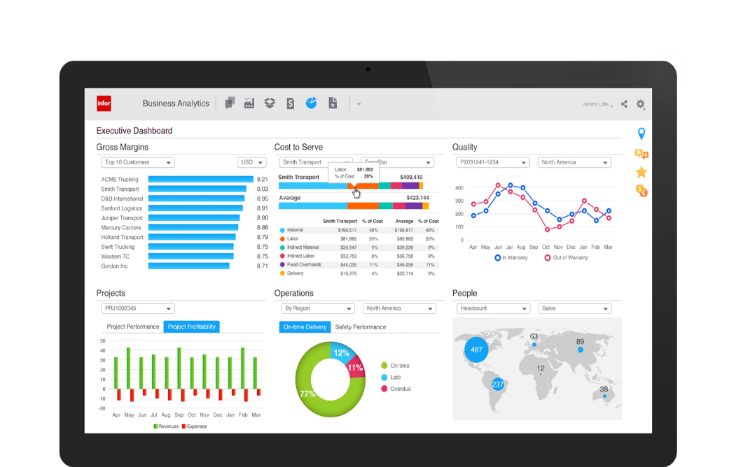
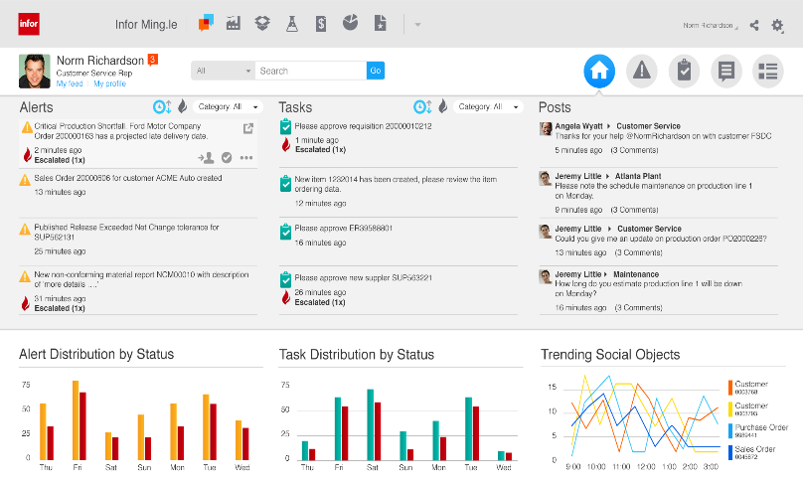
Social business?
Essential business.
Infor Ming.le makes collaboration natural and efficient.
Easy access to all systems
Stay connected with
real-time alerts
Communicate, collaborate and share information with colleagues
Automated tasks let you respond faster
In-context analytics deliver key indicators at a glance

Slide 25
Micro-verticals
Built to meet the unique business process requirements of:
OEM Vehicle Builders
Tier 1 Suppliers
Aftermarket Parts
Specialty Vehicles

Slide 26
Synopsis
We have precise solutions for your respective industry.
We figure out the strains in your industry.
Our innovative technology will accelerate your productivity and service.

Slide 27
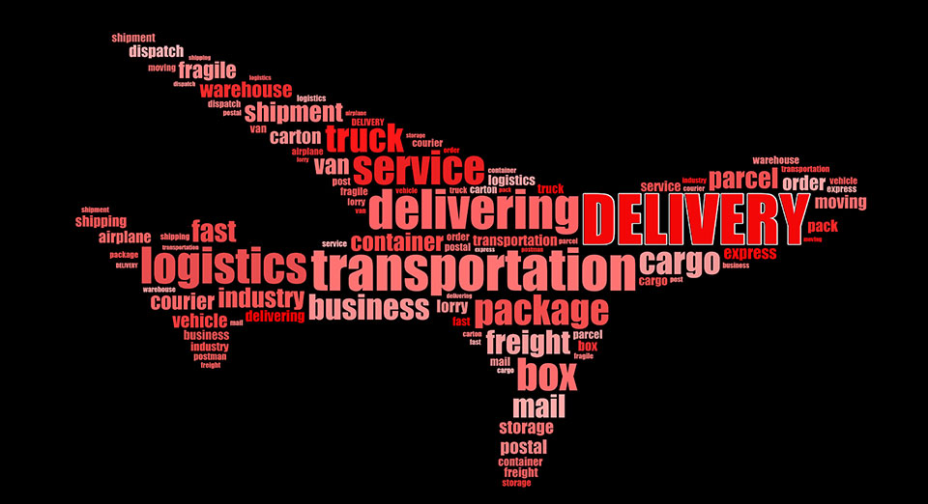
Delivery Model

Slide 28
DELIVERY MODEL
Onsite
offshore
hybrid
GLOBAL ENGAGEMENT MODEL
Proven Engagement Model for Delivering Reliable Solutions & Services across the globe
Local resources across the globe
On-demand Service & Support
ISO in various countries Certified, Tested and Delivered
On-site, Off-site, Off-shore and Near Shore delivery models
250+ skilled professionals serving customers
Application Managed Services

Slide 29

Why Merino
An Unbiased & Customer centric company

Slide 30








WHY MERINO
12+ years of rich experience handling vivid industries, distinguish complexities .
A complete technology solutions partner covering a comprehensive range of enterprise and IT solutions.
Having a manufacturing unit of our own, provides us with the essential know-how to guide businesses better.
Committed
Collaboration
Speed
Cost Efficient
Experience
Flexibility
Innovation
Global Offices

Slide 31

Thank you
Contact us:
Merino Services Limited
Corporate Office 70, KLJ Complex, Moti Nagar, New Delhi – 110015, India
+91 11 45068300
@
contact@merinoindia.com
INDIA USA EUROPE UAE SINGAPORE MALAYSIA INDONESIA

